Slide 1
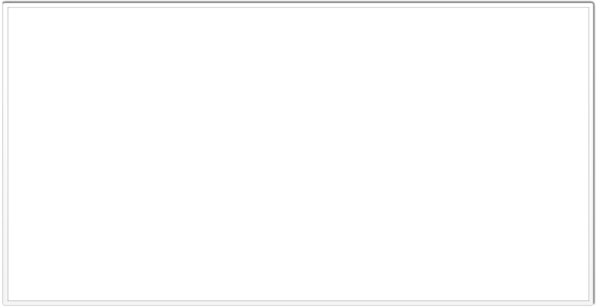
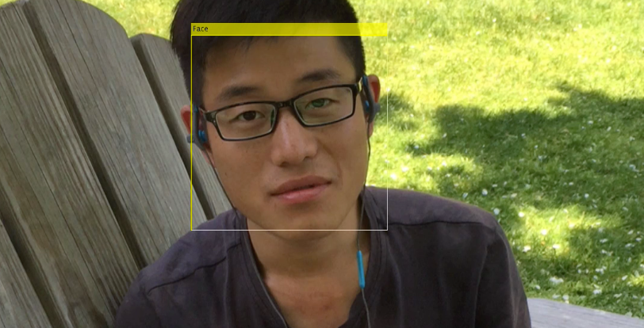
fACE TRACKING
Team Members:
Yunfeng Wei
Yichen Zhai
Xuanyu Liu
Zhe Han

Slide 2
Part I:
Face Tracking Process
Extract every frame from video we need to handle
For every frame, detect the face area
Draw the face area
Reconnect these frame to output a new video

Slide 3
Part II:
Boosted Cascade of Simple Features
Pre-processing train images
Features: Haar-like features
Boosting Algorithm

Slide 4
Pre-processing train images
Pre-processing stages for face detector training:
(a) using images with faces to generate face examples;
(b) using images without faces to generate non-face examples;
(c) resize all of the images into 12x12 pixels;

Slide 5

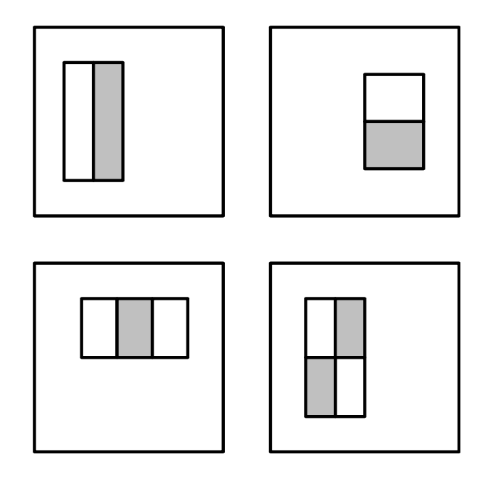
Haar-like features
Simple features used in boosting-based face detector (Viola and Jones 2004):
(a) difference of rectangle feature composed of 2–4 different rectangles (pixels inside the white rectangles are subtracted from the gray ones);
(b) the first and second features selected by AdaBoost. The first feature measures the differences in intensity between the eyes and the cheeks, the second one between the eyes and the bridge of the nose.

Slide 6
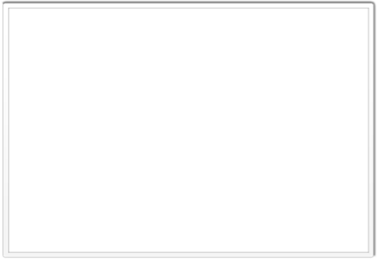
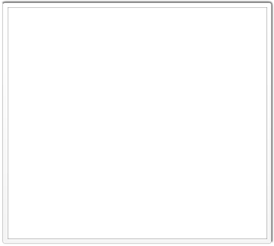
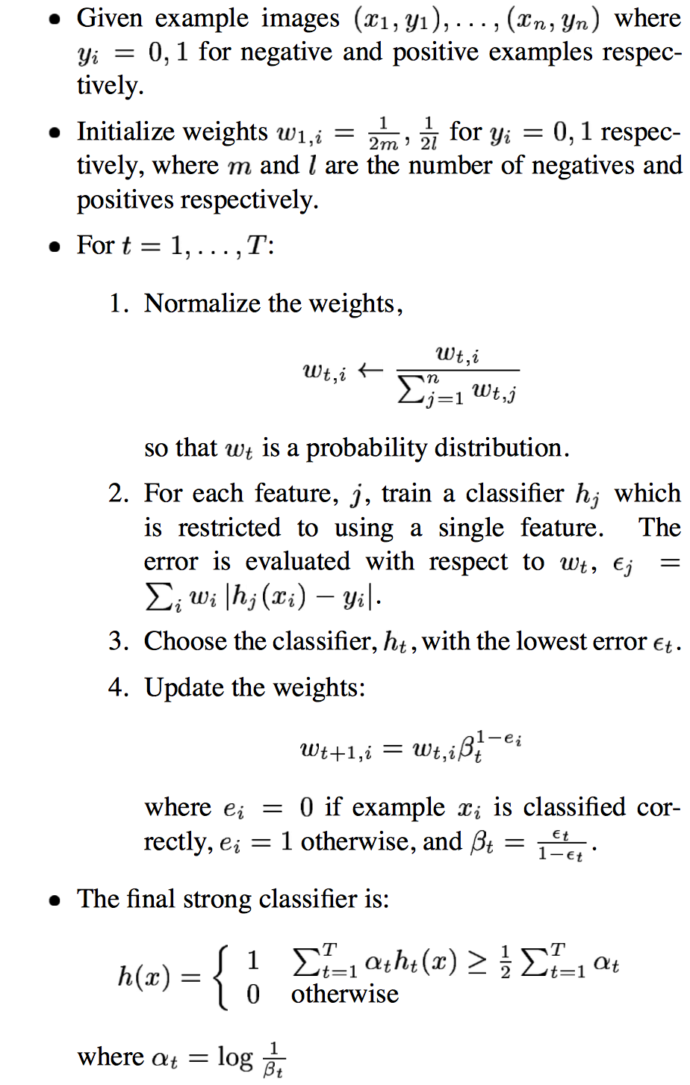
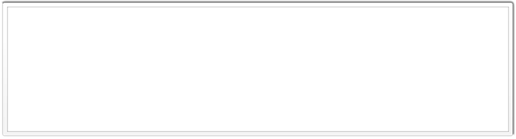
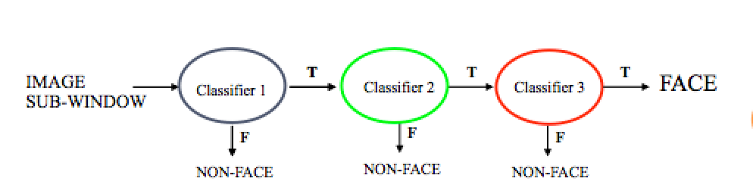
Adaptive Boosting Algorithm
P. Viola and M. Jones.
Rapid object detection using a boosted cascade of simple features. CVPR 2001.
P. Viola and M. Jones. Robust real-time face detection. IJCV 57(2), 2004.

Slide 7
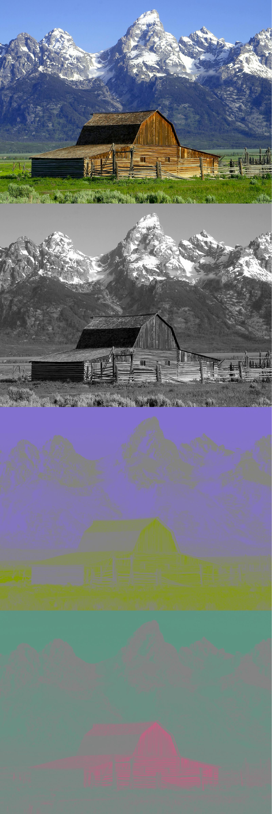
Part III:
Skin detection based on YCbCr color range
YCbCr is a way of encoding RGB information. Y is luminance, Cb and Cr are the blue-difference and red-difference chroma components.

Slide 8

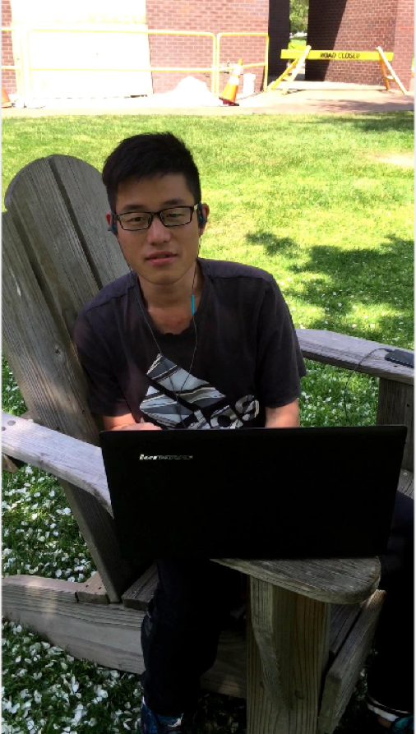
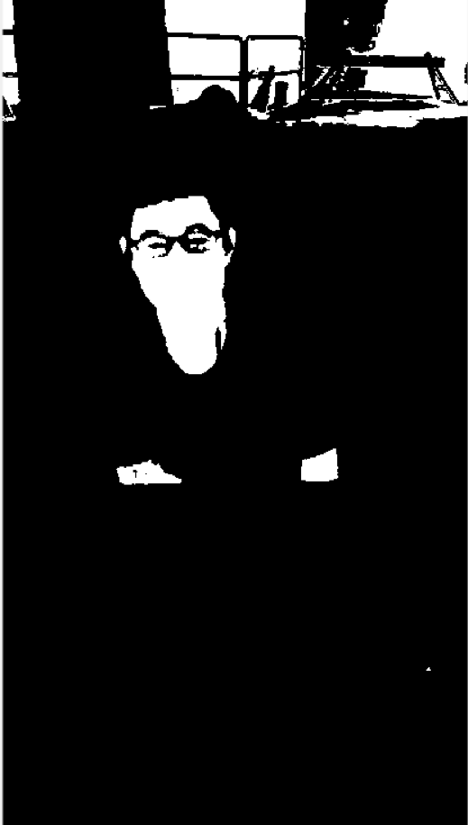
Original image
Two value image, black and white, use YCrCb space

Slide 9



Morphological closing operation, enlarge white areas, to connect areas divided by glasses
Morphological opening operation, shrink white areas which are enlarged before, also eliminate white blobs
Fill in holes (fill in black parts surrounded by white areas

Slide 10

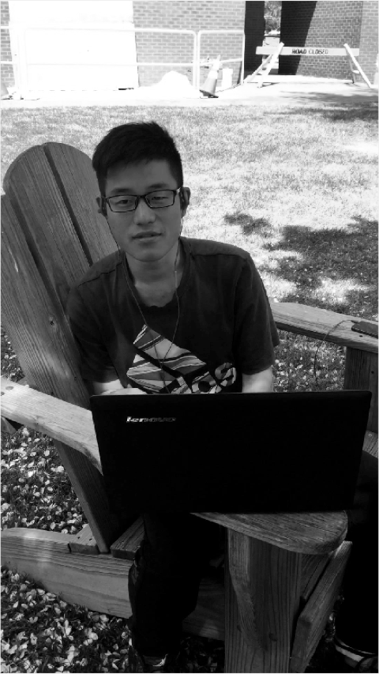
Get Potential Skin Area
Calculate the area and position of all the connected white areas, find out the four largest one, and crop the four largest one in gray scale from the original image

Slide 11
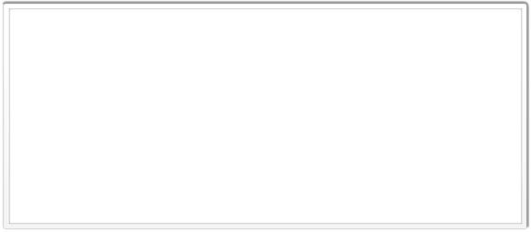

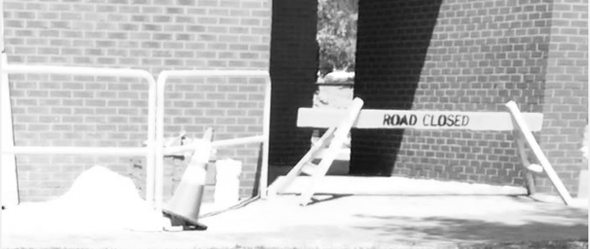
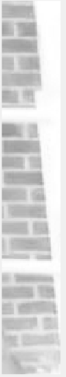

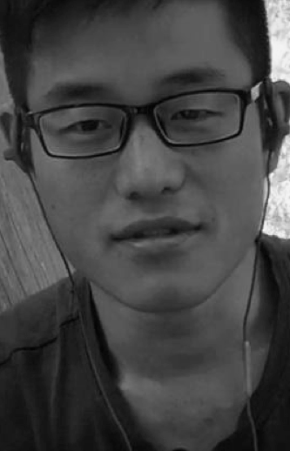
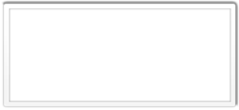
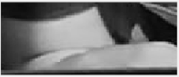
These are detected potential skin areas

Slide 12
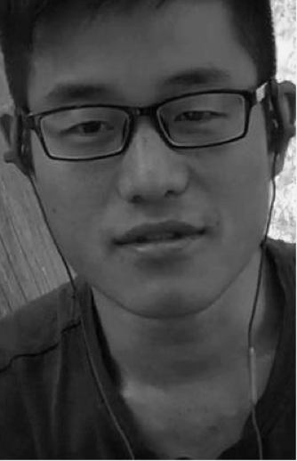
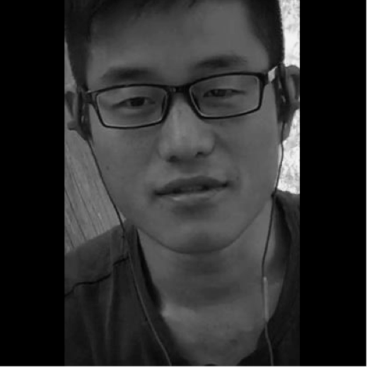
Find the areas within 0.8 - 2.0 ratio (height to width)
copy these areas to a square space, because the detector could only deal with 24 by 24 square images in gray scale

Slide 13
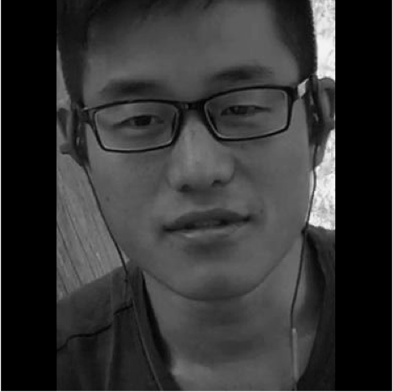
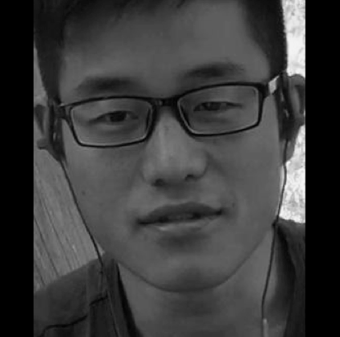
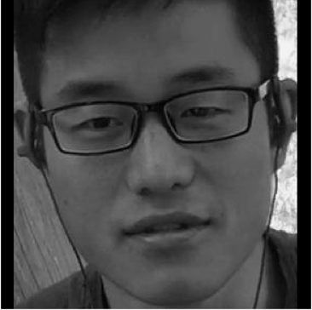
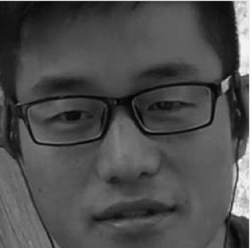
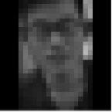
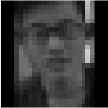
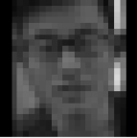
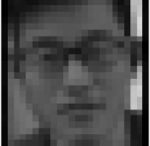
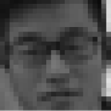
Crop 90%, 80%, 70%, 60% square parts of this image, to eliminate the neck part
resize the 5 images to 12 by 12 image patches

Slide 14
the end

